Slide 1
UNIVERSITY ADMISSION APP
PROGRAMMING FUNDAMENTAL PRESENTATION

Slide 2
GROUP MEMBERS
MAHNOOR KHALID
JANEES ASGHAR
SYEDA ALISHA
MUHAMMAD SANI
SADIA

Slide 3
POINTS TO DISCUSS
WHY THIS APP
PROBLEM ANALYZATION
PROBLEM REQUIREMENT
DESIGNING
Implementation and testing
Conclusion

Slide 4
WHY THIS APP ?
The current university admission process faces several challenges that impact its efficiency and accessibility.
One of the primary issues is the complexity and lack of transparency in the application procedure, leading to confusion among prospective students.
The absence of a unified platform for submitting applications and tracking their progress creates inconvenience and inefficiencies for both applicants and admission staff.

Slide 5
PROBLEM ANALYZATION
Students face difficulties in collecting information about various universities, including eligibility criteria, merit requirements, and application procedures, after completing their intermediate education.
Students find it challenging to gather comprehensive details about multiple universities in one place.
The process of individually researching each university's admission requirements is time-consuming.
Students may lack clarity on eligibility criteria and merit requirements for different universities.

Slide 6
PROBLEM REQUIREMENT
Needed to develop a centralized system, such as a mobile application, that provides information about various universities.
The system should allow students to explore eligibility criteria, merit thresholds, and application procedures for different universities within a single platform.
Design an intuitive interface to make it easy for students to navigate and access information.

Slide 7
DESIGNING (FLOWCHART)
start
University application app
Displaying Universities list
Fill the form

Slide 8
FLOWCHART CONTINUE………..
Enter the university you want to apply in
merit =30% matric marks+40%intermediate marks+30 %NTS marks
if NUST (merit =30% matric marks+40%intermediate marks+10 %NTS marks+20%NAT marks)
Display merit
Display eligibility criteria

Slide 9
FLOWCHART CONTINUE………..
If (merit >=eligibility criteria)
You cannot apply for this university
Display test Fee Voucher
Thank you for using this app
END

Slide 10
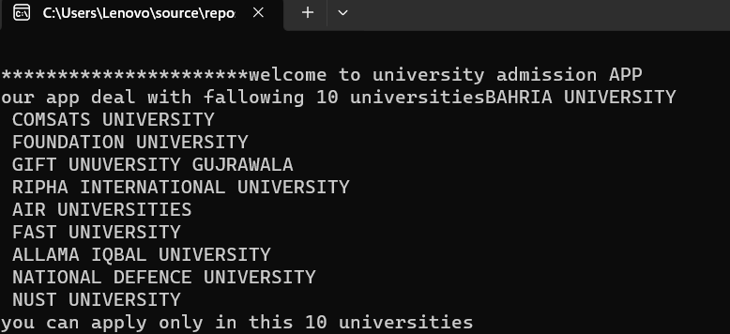
IMPLEMENTATION ,TESTING AND VERIFYING
MAIN PROGRAM:
int main()
{
char c;
string name;
cout << "\n**********************welcome to university admission APP";
\\ UNIVERSITIES WE DEAL WITH
cout << "\nour app deal with fallowing 10 universities";
cout << "BAHRIA UNIVERSITY \n COMSATS UNIVERSITY\n FOUNDATION UNIVERSITY \n GIFT UNUVERSITY GUJRAWALA \n RIPHA INTERNATIONAL UNIVERSITY \n AIR UNIVERSITIES \n FAST UNIVERSITY \n ALLAMA IQBAL UNIVERSITY\n NATIONAL DEFENCE UNIVERSITY \n NUST UNIVERSITY ";
cout << "\nyou can apply only in this 10 universities";

Slide 11
Main continue………
cout << "\nyou can apply only in this 10 universities“
foam();
From here
form function will begin
void foam()
{
int day, month, year;
char dash;
string gender, matric, intermediate, password;
char name[15];
char fn[15];
char arr[50];
char sch[25];
char hal[25];
char e[50];
char f[25];
char n[15];
char m[15];

Slide 12
Foam function……
cout << "\n^^^^^^^^^^^^^^^^^^^^^^^^^^^^^^^^UNIVERSITY APPLICATION FORM^^^^^^^^^^^^^^^^^^^^^^^^^^^^ ";
cout << "\n ";
cout << " \n--------------------------- ";
cout << "\nPERSONAL INFORMATION:";
cout << " \n--------------------------- ";
cout << "\nenter your email:";
cin.ignore();
cin.get(e, 50);
cout << "\nenter your password:";
cin >> password;
cout << "\nEnter your Full Name: ";
cin.ignore();
cin.get(name, 15);
cout << "\nEnter yours father Full Name: ";
cin.ignore();
cin.get(fn, 25);
cout << "\nEnter your Date of Bith: ";//Enter your date of birth (dd-mm-yyyy)
cin >> day >> dash >> month >> dash >> year;
cout << "\nenter your CNIC number :";
cin.ignore();
cin.get(n, 15);

Slide 13
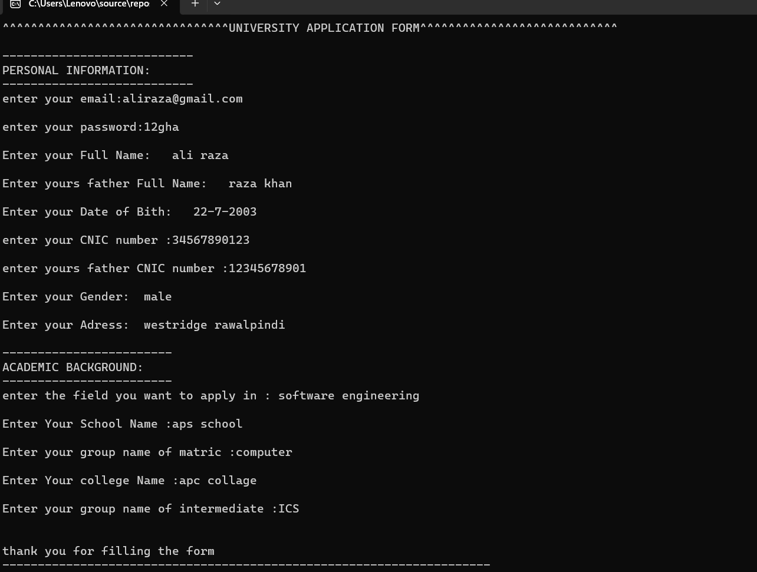
cout << "\nenter yours father CNIC number :";
cin.ignore();
cin.get(m, 15);
cout << "\nEnter your Gender: ";
cin >> gender;
cout << "\nEnter your Adress: ";
cin.ignore();
cin.get(arr, 50);
cout << "\n------------------------ ";
cout << "\nACADEMIC BACKGROUND:";
cout << "\n------------------------ ";
cout << "\nenter the field you want to apply in : ";
cin.ignore();
cin.get(f, 25);
cout << "\nEnter Your School Name :";
cin.ignore();
cin.get(sch, 25);
cout << "\nEnter your group name of matric :";//e.g : biology;computer;humanity
cin >> matric;
cout << "\nEnter Your college Name :";
cin.ignore();
cin.get(hal, 25);
cout << "\nEnter your group name of intermediate :";//e.g : fsc;ics;FA
cin >> intermediate;
cout << "\n ";
cout << "\nthank you for filling the form";
cout << "\n---------------------------------------------------------------------";
}

Slide 14
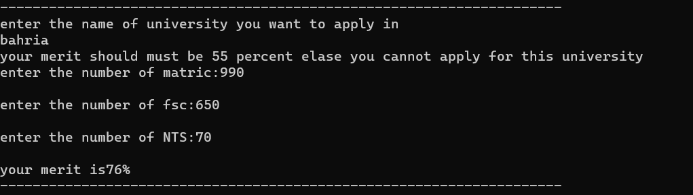
MERIT FUNCTION….
foam();
do
{
int matric, fsc, nts;
cout << "\nenter the name of university you want to apply in" << endl;
cin >> name;
merit(name);
void merit(string name)
{
if (name == "bahria" || name == "foundation" || name == "gift" || name == "allama iqbal" || name == "national defence university")
{
cout << "your merit should must be 55 percent elaseyou cannot apply for this university";
}
else if (name == "nust" || name == "fast" || name == "air" || name == "comsats")
{
cout << "your merit should must be 70 percent elase you cannot apply for this university";
}
else if (name == "ripha")
{
cout << "your merit should must be 40 percent elase you cannot apply for this university";
}
}

Slide 15
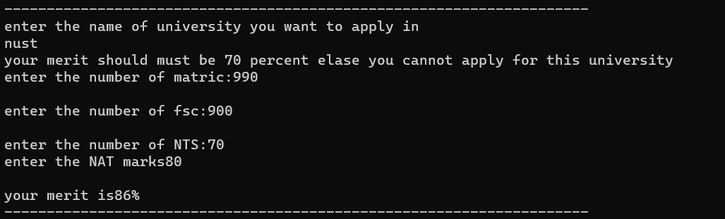
AGAIN MAIN……..
merit(name);
cout << "\nenter the number of matric:";
cin >> matric;
cout << "\nenter the number of fsc:";
cin >> fsc;
cout << "\nenter the number of NTS:";
cin >> nts;
int merit = matric * 30 / 1000 + fsc * 40 / 1000 + nts * 30 / 100;
if (name == "nust")
{
int NAT;
cout << "enter the NAT marks";
cin >> NAT;
int merit = matric * 30 / 1000 + fsc * 40 / 1000 + nts * 10 / 100 + NAT * 20 / 100;
}
cout << "\nyour merit is" << merit << "%";

Slide 16
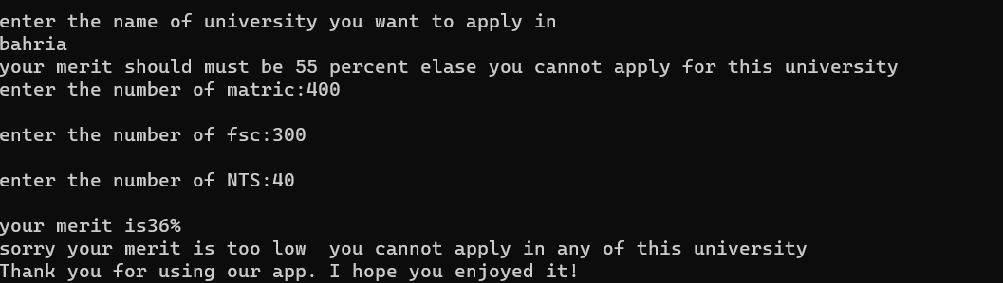
Main…….
cout << "\nyour merit is" << merit << "%";
if (merit < 40)
{
cout << "\nsorry your merit is too low you cannot apply in any of this university";
break;
}

Slide 17
if (name == "bahria" || name == "foundation" || name == "gift" || name == "allama iqbal" || name == "national defence university") { if (merit < 55) { cout << "\nsorry your merit is low for this university you cannot apply in this university "; } else { feevoucher(name); } }

Slide 18
Fee voucher function: void feevoucher(string name) { if (name == "bahria" || name == "foundation" || name == "gift" || name == "allama iqbal" || name == "national defence university") { cout << "\n---------------------------------------------------------------------"; cout << "\nyour fee voucher for this university is"; cout << "\nyour entry test fees is :1200"; cout << "\nother credential : 800"; cout << "\nyour total fee is : 2000"; cout << "\n---------------------------------------------------------------------"; } else if (name == "nust" || name == "fast" || name == "air" || name == "comsats") { cout << "\n---------------------------------------------------------------------"; cout << "\nyour fee voucher for this university is"; cout << "\nyour entry test fees is :1800"; cout << "\nother credential : 1200"; cout << "\nyour total fee is : 3000"; cout << "\n---------------------------------------------------------------------"; } else if (name == "ripha") { cout << "\n---------------------------------------------------------------------"; cout << "\nyour fee voucher for this university is"; cout << "\nyour entry test fees is :1500"; cout << "\nother credential : 1000"; cout << "\nyour total fee is : 2500"; cout << "\nyours admit card for test of each university will be send to you through E-mail"; cout << "\n---------------------------------------------------------------------"; } }

Slide 19
if (name == "bahria" || name == "foundation" || name == "gift" || name == "allama iqbal" || name == "national defence university")
{
if (merit < 55)
{
cout << "\nsorry your merit is low for this university you cannot apply in this university ";
}
else
{
feevoucher(name);
}
}
else if (name == "nust" || name == "fast" || name == "air" || name == "comsats")
{
if (merit < 70)
{
cout << "\nsorry your merit is low for this university you cannot apply in this university ";
}
else
{
feevoucher(name);
}
}
else if (name == "ripha")
{
if (merit < 40)
{
cout << "\nsorry your merit is low for this university you cannot apply in this university and you also cannot apply in any else university ";
}
else
{
feevoucher(name);
}
break;
}

Slide 20
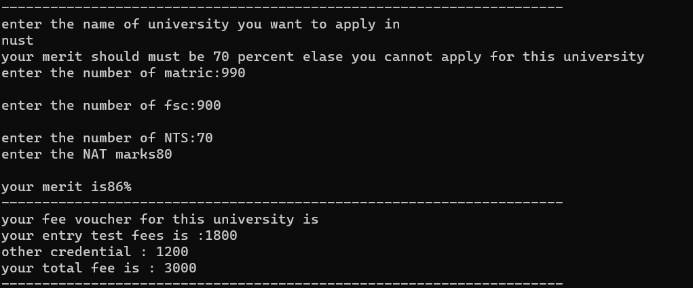
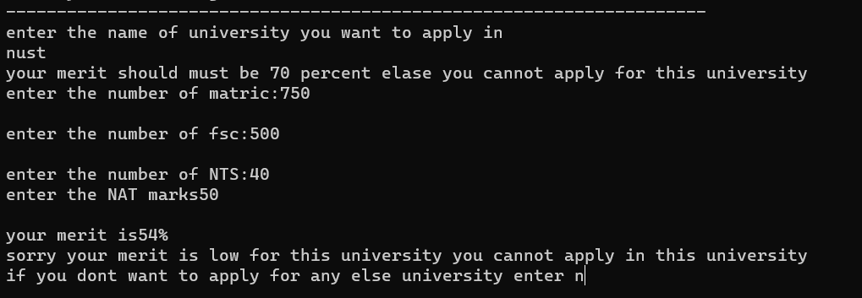
When you are not eligible to apply in university
When you are eligible to apply in university

Slide 21
Main…………….
cout << "\nif you dont want to apply for any else university enter n";
cin >> c;
} while (c != 'n');
cout << "\nThank you for using our app. I hope you enjoyed it!";
return 0;
}

Slide 22
Conclusion:
Successful integration of cutting-edge technology into the admission process, enhancing efficiency and accuracy.
Improved accessibility for diverse applicant demographics, ensuring inclusive and equal opportunities for all.
Establishment of stringent ethical standards safeguarding data security, confidentiality, and procedural integrity throughout the admission program.
Positive impact on the user experience, simplifying the application process while maintaining transparency and fairness.
Collaboration with educational institutions and stakeholders to gather feedback and implement necessary enhancements.
The transformative nature of the program marks a significant advancement in reshaping higher education admissions, emphasizing fairness, transparency, and technological innovation.

Slide 23
THANKYOU

Slide 24
ANY QUESTION ?

